Slide 1

Pipelined SAR with Comparator-Based Switch-Capacitor Residue Amplification
Pedro Henrique Köhler Marra Pinto and Frank Sill Torres
Universidade Federal de Minas Gerais (UFMG), Brazil
Florianopolis, Feb. 29, 2016

Slide 2
Outline
Preliminaries
Pipelined Successive Approximation Register (PSAR)
  General Architecture
  Switch-Capacitor Residue Amplification
  Zero-Crossing Detection
Results
Conclusion

Slide 3
Preliminaries
Successive Approximation Register
Generation of internal analog signal V_{D/A} with Digital Analog Converter (DAC)
Comparison of V_{D/A} with input signal V_{in}
Modification of V_{D/A} by bits D₀D₁..D_{N-1} until closest possible value to V_{in}
V_{ref} – reference voltage
S&H – Sample and Hold circuit

Slide 4
Preliminaries
Pipelined Converter
Conversion separated in clocked stages
In each stage: subtraction of conversion result from stage input
Pipelined conversion of subsequent input signals

Slide 5
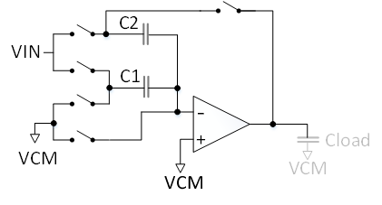
Preliminaries
Pipelined Converter - Residue Amplification
Usually: OpAmp based
Common concepts:
  Resistor network amplifier
  Switched capacitor amplifier

Slide 6
Pipelined Successive Approximation Register
Origin of Approach
ADC is based on combination of:
  Successive Approximation Register (SAR)
     Low power / low area
     Slow
  Pipelined Converter
     Fast
     High power / high area
Residue amplification
  OpAmp => several problems in nanometer technologies (e.g., size, speed, robustness against variations)
  Proposed solution based on
    Comparator-based switched capacitor amplifier
    Inverter-based zero-crossing detection

Slide 7
Pipelined Successive Approximation Register
Architecture

Slide 8
Pipelined Successive Approximation Register
Successive Approximation Converter

Slide 9
Pipelined Successive Approximation Register
Successive Approximation Converter

Slide 10
Pipelined Successive Approximation Register
Switch-Capacitor Residue Amplification

Slide 11
Pipelined Successive Approximation Register
Switch-Capacitor Residue Amplification - Architecture
Inspired by
Fiorenza, 2006, IEEE JSSC

Slide 12
Pipelined Successive Approximation Register
Switch-Capacitor Residue Amplification - Architecture
Storage capacitor
CS
VF
C2
I
ZCD
C1
Zero-Crossing Detection

Slide 13
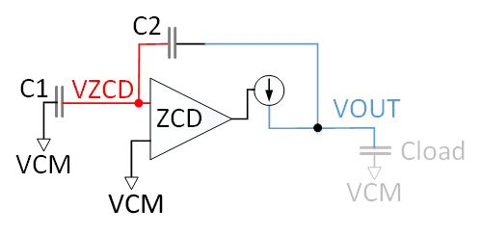
Pipelined Successive Approximation Register
Switch-Capacitor Residue Amplification - Mode of Operation
1st: VIN is sampled on C1 and C2
2nd: Charge transfer phase + VOUT set to GND level
3rd: Current source activated until VZCD crosses VCM

Slide 14
Pipelined Successive Approximation Register
Zero-Crossing Detection - Architecture
Inspired by
Chao, 2013, ISSCC

Slide 15
Pipelined Successive Approximation Register
Zero-Crossing Detection – Mode of Operation
1st: Inverter shortened and VINV set to switch voltage of Inverter (VTH_{INV})
2nd: VIN (ramp) connected to inverter, inverter chain amplifies signal

Slide 16
Pipelined Successive Approximation Register
Control Flow

Slide 17
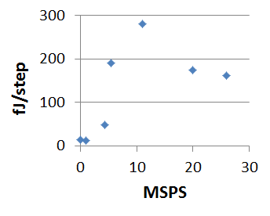
Results
Overview
Realized (on schematic level) in comercial 65nm technology
VDD = 1.2 V, Vref = 1 V, VCM = 0.5 V
f_{sample} | 4.4 MSPS
DNL | +0.45 / -0.48 LSB₁₁
INL | +0.43 / -0.53 LSB₁₁
Power | 440 µW
E/step [P/(f_{sample}*2¹¹)] | 48.8 fJ/step
[2]
[3]
[4]
[1]
[6]
[5]

Slide 18
Results
Integral Non-Linearity (INL)

Slide 19
Conclusion
Combination of two ADC concepts
Comparator-Based Switch-Capacitor Residue Amplification
Inverter-based zero-crossing detection
11 bit ADC implemented in 65 nm technology with low power and moderate speed

Slide 20

franksill@ufmg.br
Thank you!
ART
OptMA^{lab} / ART
www.asic-reliability.com

Slide 21
References
[1] A Fully-Differential Zero-Crossing-Based 1.2V 10b 26MS/s Pipelined ADC in 65nm CMOS
[2] A 12b 11MS/s successive approximation ADC with two comparators in 0.13μm CMOS
[3] Pipeline of Successive Approximation Converters with Optimum Power Merit Factor
[4] A 2.9-mW 11-b 20-MS/s Pipelined ADC with Dual-Mode-Based Digital Background Calibration
[5] An energy-efficient 1MSps 7µW 11.9fJ/conversion step 7pJ/sample 10-bit SAR ADC in 90nm
[6] ADC Ultra-Low Power for Micro-Sensors

Slide 22
Dynamic Comparator

Slide 23
Pipelined Successive Approximation Converter
Schematic – Flow
Load - New analog input into the SAC
ZERO - Resetting of SAC’s output bits
SET Bx - Successive bit setting and result estimation
LAST-BIT - Estimation of result for last Bit (Bit n)
WAIT - Generation of input analog signal for the next stage (only 1st and 2nd SAC)

